Slide 1
TISSUE FLUID
BY MILON BUYI

Slide 2
DEFINITION
This is the fluid that is derived from blood plasma by filtration through capillaries.
It is found around tissue cells and contains molecules that enter from or exit to the capillaries.
The body’s internal environment consists of tissue fluid and blood that bathes cells.
It may be called the interstitial or intercellular fluid.

Slide 3
FORMATION OF TISSUE FLUID
Tissue fluid is formed by ultrafiltration i.e. hydrostatic pressure of blood forces small molecules to exit blood capillaries via fine pores on the basement membrane but large molecules are held back.
Fluid movement in and out of capillaries depends on the balance between the blood pressure (hydrostatic pressure) and osmotic pressure (solute potential).
Osmotic pressure is created by the presence of salts and plasma proteins in blood while blood pressure is created by the pumping action of the heart and the resistance to blood flow caused by the small size of the lumen of capillaries.
At the arterial end of the capillary bed, blood pressure is higher than osmotic pressure of blood.
This results into the forced exit of small molecules like glucose, water, amino acids, ions, oxygen, and small plasma protein molecules via fine pores on the basement membrane of arterioles BUT large plasma protein molecules and red blood cells are retained.

Slide 4
TISSUE FLUID FORMATION CONTINUED
Midway along the capillary bed where the blood pressure is lower, the two forces of blood pressure and osmotic pressure essentially cancel each other and the substances diffuse according to their concentration gradients i.e. glucose, oxygen and other solutes diffuse out of the capillary while carbondioxide and other wastes diffuse into the capillary.
No net movement of water occurs.
Control centre This is usually the brain that coordinates the information received from the various receptors and sends out instructions which will correct this deviation.
Variations in temperature of external environment are conveyed to the hypothalamus of the brain. Effector/responding organs These are parts of the body that bring about the necessary changes needed to return the system to the reference point/norm.
The hypothalamus initiates corrective responses in effectors like blood vessels and skin to restore the temperature back to the normal. The average temperature is 37oC. d. Reference point/norm This is the set level at which the system operates e. Feedback loop Hormones and/or nerve impulses that inform the receptor of any change in the system as a result of the action of the effectors.
At the venule end of the capillary bed, blood pressure is lower than osmotic pressure of blood, resulting into entry of water, carbondioxide, wastes and solutes into the capillaries. However, the total amount of fluid exiting capillaries at the arterial end exceeds that entering at the venule end.

Slide 5
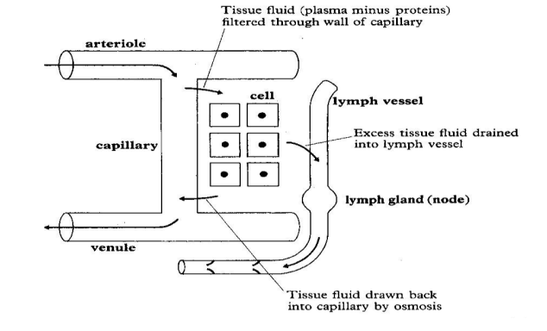
CONTID
This is because the osmotic pressure causing the entry of fluids at the venule end is lower than the blood pressure causing exit of fluid at the arterial end, resulting into failure of some fluid flowing in capillaries, forming what is called tissue fluid.

Slide 6
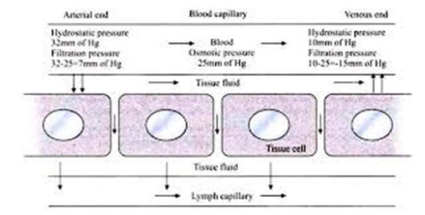
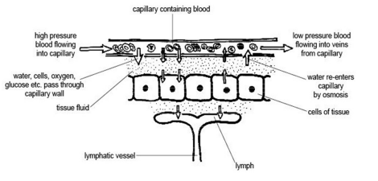
ILLUSTRATION SHOWING HOW TISSUE FLUID IS FORMED

Slide 7
NOTE
Tissue fluid is drained by the lymphatic system, where it becomes lymph which eventually passes into the veins at the same rate as it is formed, failure of which results in a condition known as oedema.
ILLUSTRATION OF OEDEMA

Slide 8
HOMEOSTASIS IN UNICELLULAR ORGANISMS AND CELLS OF MULTICELLULAR ORGANISMS
At cellular level, the internal environment of a cell is its cytoplasm while the cell’s immediate surrounding constitutes its external environment.
Tissue fluid in most animals and sap in plants, constitute the external environment of cells of multi cellular animals and plants respectively, but form the internal environment of these organisms.
The constituents of a cell cytoplasm are modulated by the partial permeability of its cell membranes and the level of activity of its enzymes.

Slide 9
CONTINUED
The cell surface membrane selectively allows entry and exit of molecules at a strictly controlled rate by diffusion gradient, osmotic gradients and active transport.
The nature and amounts of materials synthesised is controlled by the rates of protein synthesis and they catalyse most anabolic and catabolic reactions within cells.
Therefore, relative constancy of the cell’s internal environment depends on supply of metabolites, utilisation of cellular material or out put through activity of the modulators.

Slide 10
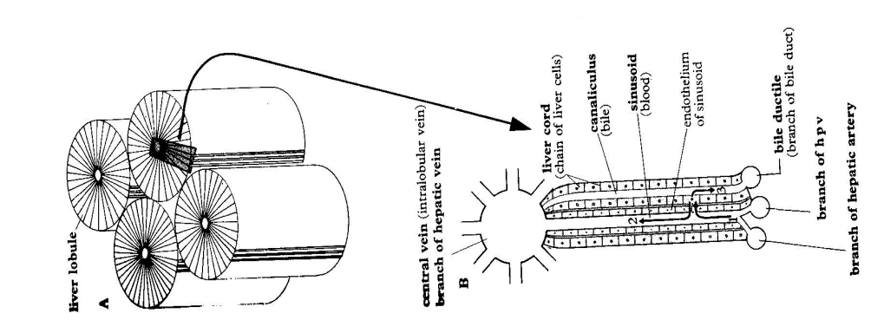
HOMEOSTATIC ROLE OF THE LIVER AND THE PANCREAS
STRUCTURE OF THE LIVER

Slide 11
DESCRIPTION OF THE STRUCTURE OF LIVER
The liver is the largest internal organ of the body, weighing about 1.5kg in humans, which is about 3.4% of the total bo dy mass.
The liver’s external shape is of little importance, but the internal structure reveals precious details.
The liver is composed of structural and functional units called lobules, which are cylindrically shaped, numbering over 100,000 and each approximating 1mm in diameter.
Hepatocytes (liver cells) closely pack in each lobule in various rows radiating outwards from the centre.
Hepatocytes (liver cells) are characterized by similarity in structure and function, prominent nuclei, Golgi complex and peroxisomes, numerous mitochondria, lysosomes, glycogen granules and fat droplets.
Peroxisomes contain catalase and other oxidative enzymes responsible for detoxification. Hepatocytes which are in contact with blood vessels bear microvilli

Slide 12
CONTINUED
Located between lobules are triads consisting of a branch of hepatic artery which brings oxygenated blood to the liver, a branch of hepatic portal vein which brings nutrients from the gut and bile duct that drains bile from the liver.
A central vein (branch of hepatic vein) runs longitudinally mid way each lobule and is linked by sinusoids to the interlobular vessels (hepatic artery and hepatic portal vein).
Sinusoids radiate from the centre to the periphery of the lobule and their endothelial lining is perforated.
Sinusoids alternate with bile canaliculi, small canals which carry bile.
Attached to the walls of sinusoids are macrophagous cells called Kupffer cells.

Slide 13
How structure is related to function in the liver:
Kupffer cells ingest worn out red blood cells, bacteria and foreign particles from the blood flowing through the liver.
Closeness of hepatocytes (liver cells) with sinusoids and canaliculi enables them to receive nutrients and expel waste substances.
The excellent blood supply provides nutrients to the cells and enables wastes to be carried away.
Hepatocytes bear numerous mitochondria for ATP production required in providing energy that facilitates some of the metabolic reactions.

Slide 14
CONTINUED
Hepatocytes, which are in contact with blood vessels, bear microvilli to increase the surface area for exchange of substances.
The liver is large, providing large surface area for metabolic reactions to occur.
Hepatocytes bear numerous peroxisomes containing catalase and other oxidative enzymes responsible for detoxification of poisonous substances in the liver.
Its tissue is elastic, enabling expansion to store large volume of blood
Hepatocytes are similar in structure (undifferentiated) enabling them to perform various metabolic functions.

Slide 15
Function of Kupffer cells
Kupffer cells ingest worn out red blood cells, bacteria and foreign particles from the blood flowing through the liver. Kupffer cells show amoeboid movements which engulf, ingest and destroy pathogens. The Kupffer cells are permanently located in the liver and thus they engulf protozoan parasites.
Kupffer cells form cytoplasmic extensions to form pseudopodia which surround and engulf microorganisms.
Microorganisms are completely surrounded by pseudopodia to form phagocytotic vesicles which pinch off the cell membrane into the cytoplasm
The phagosome fuse with the lysosome to form phagolysosome. Inside the phagolysosome are microbes which are broken down by hydrolytic enzymes.

Slide 16
Functions of the liver
Some of the functions of the liver, out of the estimated 500 that it performs, are digestive, regulatory and excretory.
It maintains a steady blood glucose concentration by conversion of glucose into glycogen (if above the norm) and vice versa (if below the norm), under the influence of hormones.
The liver’s carbohydrate metabolism involves the following;
i. Glycogenesis, promoted by insulin
ii. Glycogenolysis, promoted by glucagon
iii. Lactic acid metabolism, initiated by the enzyme lactate dehydrogenase
iv. Gluconeogenesis, promoted by cortisone and adrenaline hormone
II. The liver regulates amino acids and proteins (protein metabolism) in the body.
Excess amino acids are not stored in the body, any surplus is gotten rid of by the liver through deamination.
Deamination involves removal of the amino group (-NH2) from the amino acid to form ammonia, which in mammals is converted through a series of reactions (ornithine cycle) to urea, CO(NH2)2, which is shed from the liver cells into the blood stream and transported to the kidney for excretion.
The amino acid residue is fed into the carbohydrate metabolism pathway and oxidised to release energy.

Slide 17
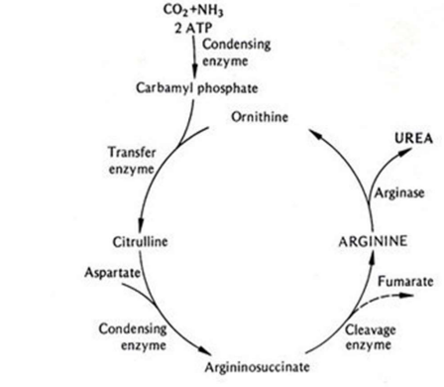
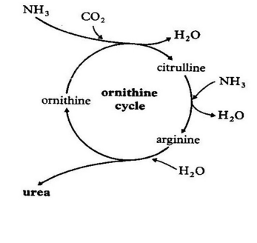
ORNITHINE CYCLE

Slide 18
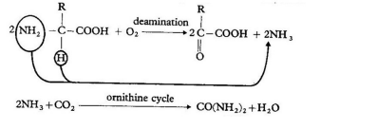
CONTINUED
The liver also carries out transamination i.e. it transfers amino groups from amino acids to other organic compounds to form amino acids that are deficient in the diet

Slide 19
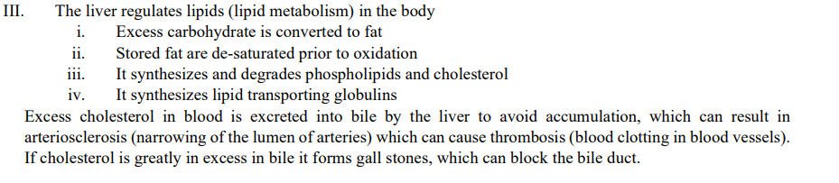
CONTINUED

Slide 20
CONTID
IV. The liver forms red blood cells in the foetus and breaks down worn out red blood cells in adults.
The liver’s Kupffer cells break down worn out red blood cells to form the bile pigment, bilirubin, which is excreted in bile.
The haemoglobin is broken down into globin, a protein and haem, from which iron is removed and stored
V. The liver detoxifies poisonous substances i.e. naturally occurring compounds absorbed by the body which can be toxic if allowed to accumulate are rendered harmless by the liver cells (hepatocytes) e.g. ethanol is oxidised to ethanal. Products of detoxification are usually excreted, but sometimes they are stored
VI. It synthesizes plasma proteins from amino acids. They include albumin (a transport molecule), globulin (a transport molecule of hormones), prothrombin and fibrinogen (clotting factors)

Slide 21
CONTINUED
VII. The liver produces bile, which is a mixture of salts and cholesterol. Bile emulsifies fats during digestion in the duodenum
VIII. The liver stores fat soluble vitamins A, D, E, K and water soluble vitamins B12 and C.
IX. The liver stores minerals like iron, potassium, copper, zinc and trace elements
X. The liver stores up to 1500cm3 of blood in its vast network of blood vessels, hence acting as a blood reservoir during emergency cases
XI. The liver destroys all hormones after exerting their effects in the body

Slide 22
REGULATION OF BLOOD GLUCOSE
The concentration of glucose is 90-100mg of glucose per 100cm3 approximately 0.1% or 0.1g per 100cm3 of blood.
Glucose in blood provides the cells of a mammal’s body with an energy source.
If the concentration of blood glucose falls, cell respiration will be slowed and cells will die. Cells in the brain are particularly susceptible and a lack of glucose causes coma.
On the other hand, too high a blood glucose concentration makes the water potential of blood to lose water by osmosis.
The glucose level may lower to 70mg per 100cm3 of blood, this is known as hypoglycaemia or rise to 150-200mg of blood and this is known as hyperglycaemia.

Slide 23
HOW THE LIVER AND PANCREAS INTERACT TO MAINTAIN GLUCOSE LEVELS CONSTANT
Hyperglycaemia stimulates the beta cells of the islets of Langerhans in the pancreas to secrete the hormone insulin into blood (occurs when the rate of glucose intake from the gut exceeds the rate of oxidation or conversion to glycogen).
Insulin binds to body cells with insulin receptors and leads to processes which reduce glucose concentration, for example;
i. Increased cellular respiration in muscle and liver cells to form carbondioxide and water
ii. Increased glycogenesis (formation of glycogen from glucose) in muscle and liver cells
iii. Increased conversion of glucose to fat and protein in adipose tissue
iv. Increased uptake of glucose in muscle cells

Slide 24
CONTINUED
Hypoglycaemia inhibits insulin secretion but stimulates alpha cells of the islets of Langerhans in the pancreas to secrete the hormone glucagon into blood.
Glucagon binds to liver cells since they are the only ones with glucagon receptors, causing them to increase blood glucose level through;
i. Increased glycogenolysis (hydrolysis of glycogen to glucose)
ii. Increased formation of glucose from amino acids and glycerol.
The formation of glucose from non-carbohydrate sources is called gluconeogenesis.
This leads to wasting away of tissues, which occurs in extreme starvation, causing the blood sugar in the hepatic artery to be higher than that in the hepatic vein.

Slide 25
Note:
When blood glucose levels return to normal levels, the circulating insulin and glucagon hormones are metabolized and then removed at the kidneys, and so rapidly disappear from the blood. 2. Insulin and glucagon are not the only hormones that control the blood glucose concentration. For example;
i. Adrenaline (from adrenal medulla) causes hydrolysis of glycogen during acute stress or excitement and the usage of glucose and thus increases and reduces its concentration in blood respectively.
ii. Cortisol (from the adrenal cortex) causes formation of glucose from amino acids and glycerol when glycogen exhausts, hence increasing glucose concentration in blood.
iii. Growth hormone (from the anterior pituitary) increases the glucose concentration in blood through fat breakdown.
iv. Thyroxine (from the thyroid gland) stimulates the metabolic rate e.g. increased glucose breakdown.

Slide 26
CONTID
3. In some people there may be insufficient secretion of insulin or the cells may be insensitive to insulin, resulting into a condition known as diabetes mellitus.
Insulin dependent diabetes is caused by insufficient secretion of insulin (due to under activity of the islets of Langerhans) while insulin independent diabetes results from insensitivity of cells to insulin. Symptoms of diabetes include;

Slide 27
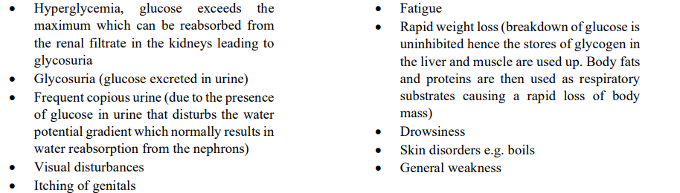
CONTID

Slide 28
Liver disorders
a. Hepatitis, which is an inflammation, caused by hepatitis viruses A, B, C, D and E.
b. Jaundice, which is characterised by a yellowish tint to the white of the eyes and a lightly pigmented skin
c. Cirrhosis, the liver becomes fatty, then fibrous and it is common in alcoholics
d. Liver cancer which is caused by exposure to chemicals like cigarette smoke, radiations e.g. X-rays, or genetic pathways.

Slide 29
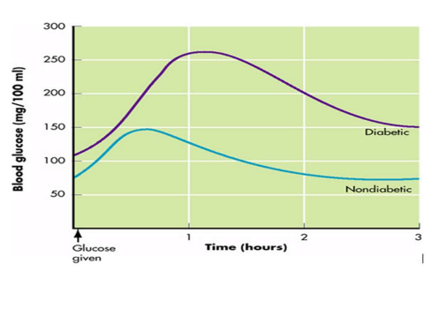
A graph showing how blood glucose varies with time in a diabetic and a Non diabetic person

Slide 30
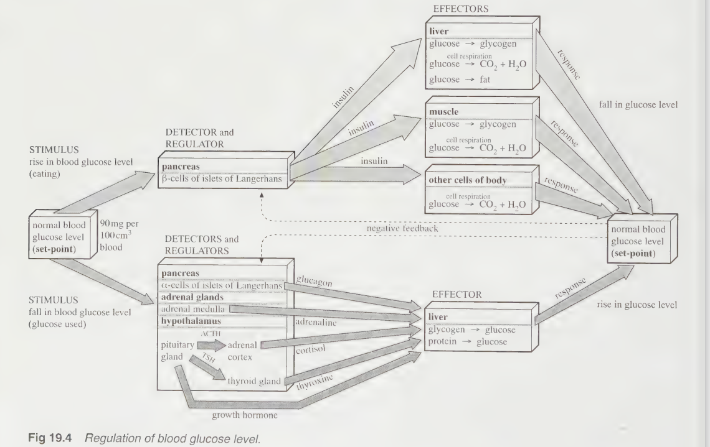
SUMMARY OF BLOOD GLUCOSE REGULATION

Slide 31
VIDEO SHOWING HOW BLOOD GLUCOSE LEVEL ARE REGULATED

Slide 32
END OF LESSON
BYE BYE

